Slide 1





Atlanta Sports Survey Project
Bai, Chen, Fan, Kumar, Weinberg, Zhang
Taped Presentation

Slide 2
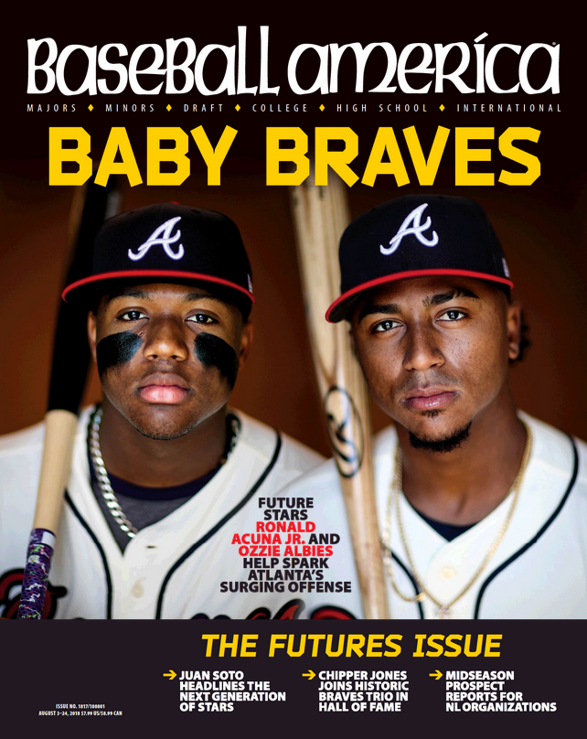
Today’s Agenda
01
Research Question
Analyzing Fandom in Atlanta Sports
02
Segmentation
What are the natural segments within fans?
What are some taste or distaste for teams within a segment?
03
Factor Analysis
What factors can influence fandom?
What might be some key drivers or deterrents of fandom for fan segment?
04
Insights and Summary
Key Takeaways

Slide 3
First Quarter: Research Question
What factors are driving the fandom of Atlanta’s 5 major sports teams?
What are the potential factors that drive different segments of fan’s taste and distaste for a specific team?
What insights can we obtain?
Using Atlanta Sports Survey Data, we conducted fandom factor analysis based on demographic segmentation of fans in Atlanta

Slide 4
Approaches to Answer Business Questions
Segmentation Analysis
To find out what are those nature forming fan segments that can help with our customized fandom analysis
Factor Analysis
Factor Dimension Reduction
How can we generate factors that may influence fandom out of original survey questions?
Driver Analysis
What are the drivers and deterrents for fandom of specific team in a fan segment?
Why do lovers love each team?
Why do haters hate each team?
How do they vary?

Slide 5
Second Quarter: Segmentation
Segmentation Approach:
Select Important Columns (19)
Demographic Variables: Age, Ethnicity, Gender, Income, Married
Other Variables: Time in Atlanta? Did you grow up in Atlanta?
Fandom scores for Braves, Dream, United, Falcons, Hawks
Standardization using min-max scaling
Use Elbow method to choose the best K
Build K-means model using the best K
Run Descriptive statistics to understand each cluster

Slide 6
Cluster Descriptions
Cluster 0
Most are Middle Aged People(35-54). Belong to Other Races. Didn’t grow up in Atlanta but have been living for more than 10 years
Cluster 1
Middle Aged people(35-54) Married and have Children < 18 Have been living in Atlanta for more than 10 years Household Income > 100k More Men in this cluster than women
Cluster 2
Most people are slightly younger than cluster_0 and cluster_1’s Most people are not married and do not have children under 18 Household income fall into 50k to 100k. Most of them are White people
Cluster 3
Most are Middle Age and old(35-64). Most of them are African Americans Have been living in Atlanta for more than 10 years
Cluster 4
Most people Age range 45-64 Most are white people. Have been living in Atlanta for more than 10 years Married and no Children Household income >100kk . More men in this cluster than women.
Cluster 5
Most are young (25-44) Asians Have been living in Atlanta for more than 10 years. Do not have children under 18. Household income over 100k. There are more men in this cluster than women.

Slide 7
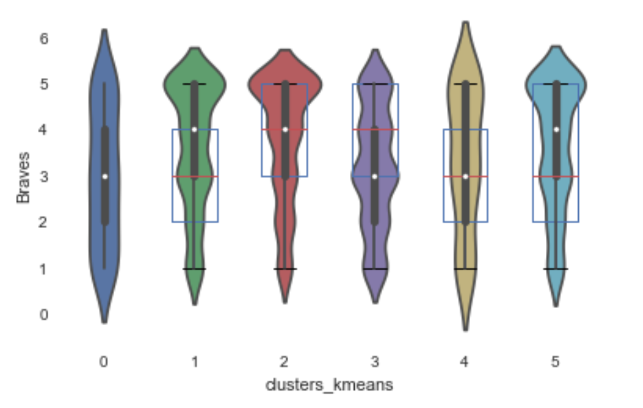
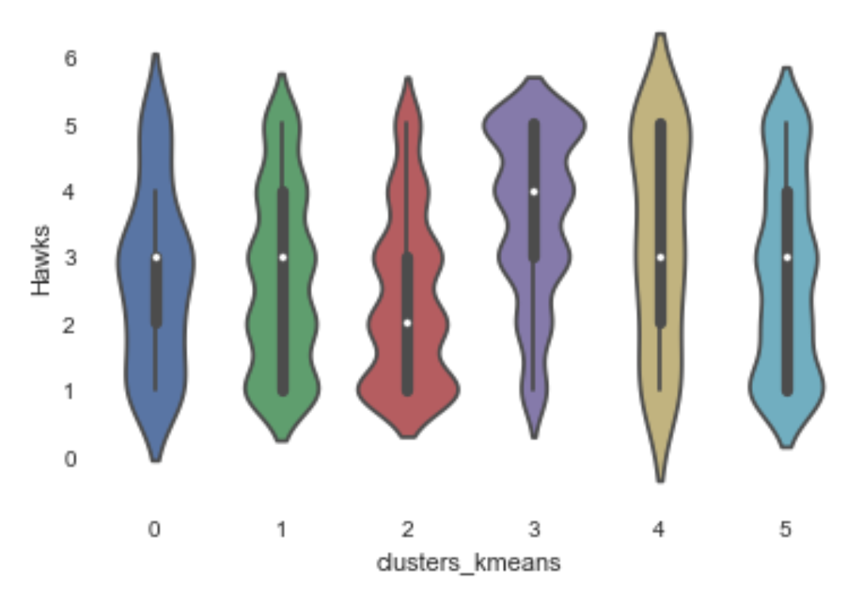
Lovers and Haters (1/2)
Lovers: Clusters 1 and 2
Haters: Cluster 0
Lovers: Cluster 3
Haters: Cluster 2
Refer back for cluster descriptions

Slide 8
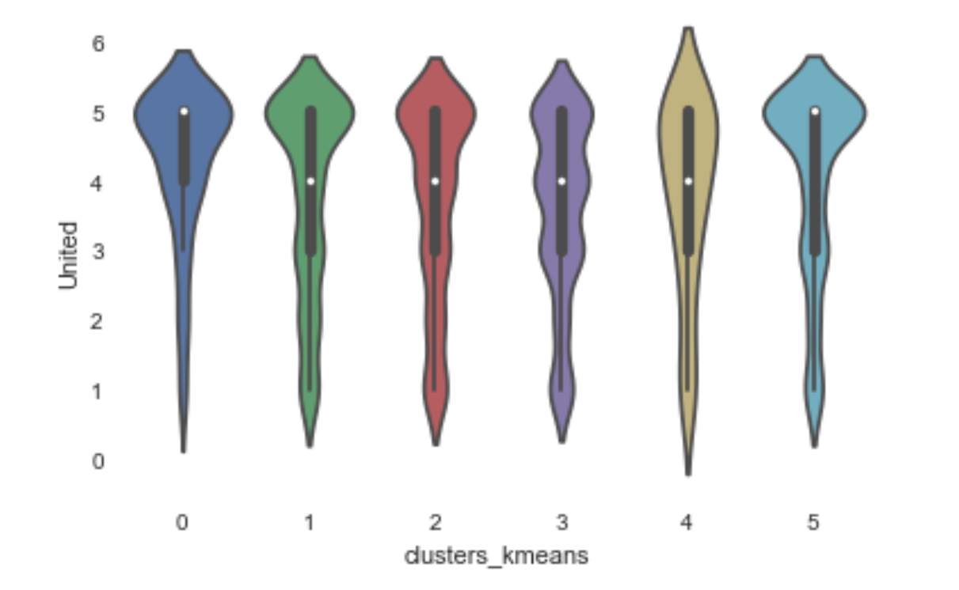
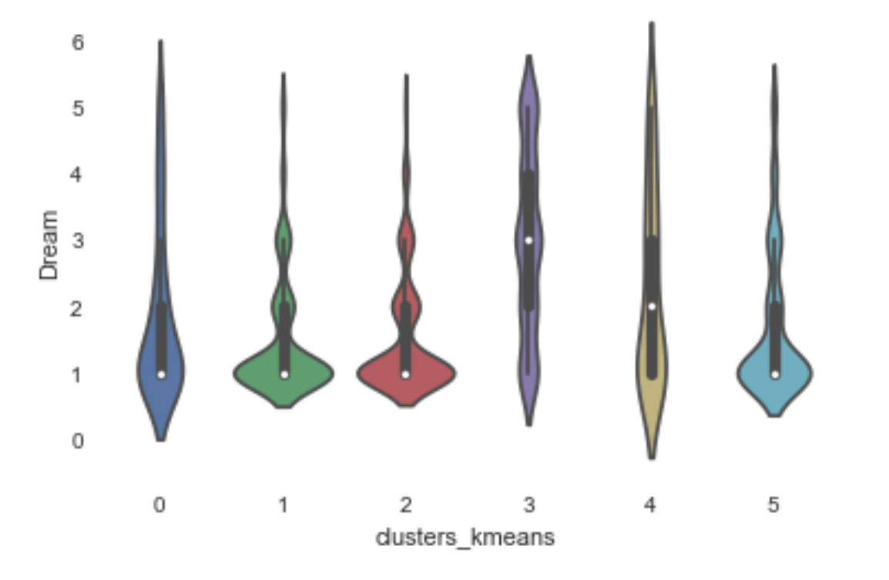
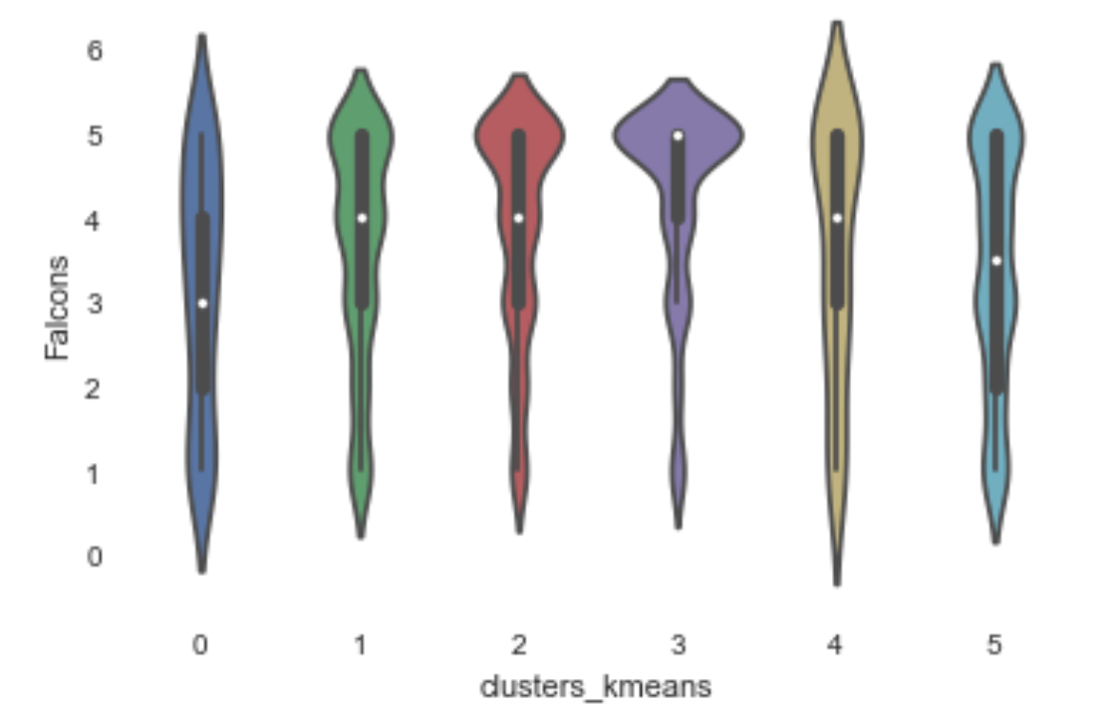
Lovers and Haters (2/2)
Lovers: Clusters 0 and 5
Haters: Cluster 3
Lovers: Cluster 3
Haters: Clusters 1 and 2
Lovers: Cluster 3
Haters: Cluster 0
Refer back for cluster descriptions

Slide 9
Third Quarter: Factor Analysis
Factor Dimension Reduction
Run “Factor Analysis” under “Dimensionality Reduction” in SPSS
21 factors extracted from 99 features in the processed data
Explaining 61.237% cumulatively of total variance
Driver Analysis
Using standardized 21 extracted features to run linear regression for each team’s fan and hater segment
Identify most influential factors for each segment’s favor or distaste for teams based on regression coefficients
Drivers for fandom
Deterrents for fandom

Slide 10
Driver Analysis Results(1/2)
Lovers
Cluster1:
ProBraves, History of Success
Cluster2:
ProBraves, History of Success
Haters
Cluster0:
ProUnited, Reputation_BravesFalconsHawks
Lovers
Cluster 3:
ProHawks, Reputation_BravesFalconsHawks
Haters
Cluster 2:
ProUnited, ProDream, ProBraves
Refer back for cluster descriptions
Notes:
C1: middle-aged (35-54) white people, married and have children, household income higher than 100K, have been living in Atlanta for more than 10 years (more men than women in this category) -- value “history of success” more(the item’s good performance itself)
C2: slightly younger generation white, not married and no children, 50K - 100K income, and have been living here more than 10 years - also “history of success”
C3: middle-aged and older(35-64) African Americans and have been living here for more than 10 years
……
For each cluster, run Linear regression with factor variables extracted before
Variables with large positive coefficients are the drivers for Lovers
Variables with large negative coefficients are the drivers for Haters

Slide 11
Driver Analysis Results (2/2)
Lovers
Cluster 0:
ProUnited, History of Success
Cluster 5:
Reputation, ProUnited
Haters
Cluster 3:
ProFalcon, RepsExpAtlUnited
Lovers
Cluster 3:
ProDream, FandomFactorsExpFamilyMembers
Haters
Cluster 1:
ConservativeBraves, ProUnited
Cluster 2:
PlayerStyles, ConservativeBraves
Lovers
Cluster 3:
ProFalcons, ProBraves
Haters
Cluster 0:
Honesty, HistoryofSuccess
Refer back for cluster descriptions
Notes:
We can infer here that those who loves Dreams definitely seem to be more open to new things and likely have their independent opinions on sports, rather than heavily influenced by conventional factors of sports. Those who are more conservative (such as those like Brave’s conservativeness) would probably hate Dreams (and also the United).
As we’d mention later, Brave’s characteristic of “conservativeness” may seem a little special here.
One additional finding would be that it seems some teams’ fan base can be more easily integrated with other teams’ fan base (for example, Falcon’s lovers might also be Brave’s lovers); however, there might be more of a ridge between “traditional teams” and more recently emerging teams with different styles, such as “United” and “Dream”.
Most sports teams here actually seem to have their own unique, more constantly built customer bases, and some of the preconceived perceptions might not be easy to change a lot. So probably a strategy for sports teams would still be to focus on their own audience and do deeper digging-in their potentials of consumption.

Slide 12
Fourth Quarter: Insights and Summary
Different questions reflect different information about each fanbase
Differences between “conservativeness”, “fun”, “excitement”, “passion”, etc.
Division of perception of teams into 2 “groups”: traditional major teams (Braves, Falcons, Hawks) and 2 newer outsider teams (United, Dream)
People talk/feel differently about each group
Teams fan bases
Braves - conservative, family oriented, white
Hawks - Atlanta natives, African-American, values team reputation
United - males, many different races, upper-class, values team reputation
Dream - Atlanta natives, African-American, have more independent opinions on sports
Falcons - Atlanta natives, African-American, also possibly like Braves

Slide 13
Appendix

Slide 14
Segmentation
The first step of our analyzing process is to cluster the survey takers using their personal information. There are two main objectives:
It can give us a better understanding of our survey takers.
We can get a general characteristic of each cluster to describe different types of people, and find the relationship between these characteristics and each cluster’s fandom to different teams.
Data Preparation on 4480 rows, 409 columns:
Create a unique survey id to refer to each response
Replace “Yes” with 1 and “No” with 0
Transform ordinal variables into numeric variables
Income (<25k to 1, range (25k, 50k) to 2 and so on..)
Age (<25k to 1, range (25, 34) to 2 and so on..)
Time in Atlanta (“Never” to 1, range (0, 2) to 2 and so on..)
Replace “Prefer not to answer” with Null
Drop all rows with Null values (2085) rows for Modelling

Slide 15
More Details about Factor Analysis
select relevant survey questions about potential indicators of team fandom
words associated with ATL sports teams → feelings about team characteristics
rating for enjoyment of games attended last season
ranking for reputation/status of team in respective league
most influential factors in forming initial team fandom
rating for roles of contributing factors play in team fandom
rating for team’s sense of community
Data Preprocessing
String categorical variable encoding + missing value handling (e.g. drop columns with >50% missing values, such as “role of factors play in your fandom - Gambling”)
Merge with previous data with segmentation labels
Run “Factor Analysis” under “Dimensionality Reduction” in SPSS, with “Varimax” method of Rotation and factor loading cutoff of |0.38|
21 factors extracted from 99 features in the processed data
Explaining 61.237% cumulatively of total variance
Construct few factors as features based on original variables

Slide 16
Factor Analysis - New Factors Generated
ProUnited (comprehensive impression of ATLUnited’s characteristics except “conservative”)
Exciting - AtlantaUnitedFC | 0.788
Successful - AtlantaUnitedFC | 0.789
Fun - AtlantaUnitedFC | 0.797
ForwardThinking - AtlantaUnitedFC | 0.75
RepresentsAtlanta - AtlantaUnitedFC | 0.706
Passionate - AtlantaUnitedFC | 0.706
Toughness - AtlantaUnitedFC | 0.637
RiskTaking - AtlantaUnitedFC | 0.626
Honest - AtlantaUnitedFC | 0.679
Innovative - AtlantaUnitedFC | 0.74
Friendly - AtlantaUnitedFC | 0.724
Value - AtlantaUnitedFC | 0.688
FamilyOriented - AtlantaUnitedFC | 0.605
Note: the left column is the original survey features consisting the factor; the right column is the loading of the original feature on the factor.

Slide 17
Factor Analysis - New Factors Generated
ProDream (comprehensive impression of ATLDream’s characteristics except “conservative”)
Exciting - AtlantaDream | 0.734
Successful - AtlantaDream | 0.677
Fun - AtlantaDream | 0.726
ForwardThinking - AtlantaDream | 0.705
RepresentsAtlanta - AtlantaDream | 0.522
Passionate - AtlantaDream | 0.719
Toughness - AtlantaDream | 0.717
RiskTaking - AtlantaDream | 0.633
Honest - AtlantaDream | 0.634
Innovative - AtlantaDream | 0.697
Friendly - AtlantaDream | 0.68
Value - AtlantaDream | 0.685
FamilyOriented - AtlantaDream | 0.601
Reputation - AtlantaDream | 0.381

Slide 18
Factor Analysis - New Factors Generated
ProHawks (comprehensive impression of ATLHawks’ characteristics except “conservative”)
Exciting - AtlantaHawks | 0.752
Successful - AtlantaHawks | 0.465
Fun - AtlantaHawks | 0.727
ForwardThinking - AtlantaHawks | 0.705
RepresentsAtlanta - AtlantaHawks | 0.448
Passionate - AtlantaHawks | 0.666
Toughness - AtlantaHawks | 0.591
RiskTaking - AtlantaHawks | 0.59
Honest - AtlantaHawks | 0.573
Innovative - AtlantaHawks | 0.725
Friendly - AtlantaHawks | 0.637
Value - AtlantaHawks | 0.604
FamilyOriented - AtlantaHawks | 0.563

Slide 19
Factor Analysis - New Factors Generated
ProFalcons (comprehensive impression of ATLFalcons’ characteristics except “conservative”)
Exciting - AtlantaFalcons | 0.742
Successful - AtlantaFalcons | 0.607
Fun - AtlantaFalcons | 0.68
ForwardThinking - AtlantaFalcons | 0.595
RepresentsAtlanta - AtlantaFalcons | 0.44
Passionate - AtlantaFalcons | 0.667
Toughness - AtlantaFalcons | 0.588
RiskTaking - AtlantaFalcons | 0.436
Honest - AtlantaFalcons | 0.523
Innovative - AtlantaFalcons | 0.521
Friendly - AtlantaFalcons | 0.607
Value - AtlantaFalcons | 0.54
FamilyOriented - AtlantaFalcons | 0.566
Reputation - AtlantaFalcons | 0.47

Slide 20
Factor Analysis - New Factors Generated
ProBraves (comprehensive impression of ATLBraves’ characteristics & Reputation except “conservative”)
Exciting - AtlantaBraves | 0.705
Successful -AtlantaBraves | 0.669
Fun - AtlantaBraves | 0.73
ForwardThinking - AtlantaBraves | 0.563
RepresentsAtlanta - AtlantaBraves | 0.552
Passionate - AtlantaBraves | 0.671
Toughness - AtlantaBraves | 0.556
Honest - AtlantaBraves | 0.527
Innovative - AtlantaBraves | 0.531
Friendly - AtlantaBraves | 0.643
Value - AtlantaBraves | 0.639
FamilyOriented - AtlantaBraves | 0.575
Reputation - AtlantaBraves | 0.497

Slide 21
Factor Analysis - New Factors Generated
Factors of Fandoms (comprehensive contributing factors for fandom)
Factor - CommunityInvolvement | 0.707
Factor - HistoryofSuccess | 0.521
Factor - HavingVibrantLocalFanCommunity | 0.743
Factor - ExcitingPlayers | 0.639
Factor - WellknownSuperstar | 0.502
Factor - FriendsBeingFan | 0.41
Factor - CoolImagerySlogan | 0.473
Factor - GreatLiveGameExperience | 0.7
Factor - AnUpstandingOrganization | 0.745
Factor - ExcitingStyleofPlay | 0.68

Slide 22
Factor Analysis - New Factors Generated
CommunitySense (team’s community sense)
CommunitySense_teamD | 0.52
CommunitySense_teamC | 0.568
CommunityaSense_teamB | 0.737
CommunitySense_teamA | 0.589
CommunitySense_teamEr | 0.721

Slide 23
Factor Analysis - New Factors Generated
RepresentsATL_expUnited (impression of whether team(except ATLUnitedFC) “Represents ATL”)
RepresentsATL_Braves | 0.503
RepresentsATL_Hawks | 0.684
RepresentsATL_Falcons | 0.631
RepresentsATL_Dream | 0.611

Slide 24
Factor Analysis - New Factors Generated
BoldPoineer_BravesFalcons (impression of Braves and Falcons being Bold and Pioneer -- “Forward-thinking” + “RiskTaking” + “Innovative”
ForwardThinking_Braves | 0.464
ForwardThinking_Falcons | 0.401
RiskTaking_Braves | 0.558
RiskTaking_Falcons | 0.438
Innovative_Braves | 0.449

Slide 25
Factor Analysis - New Factors Generated
Conservative_expBraves (impression of team’s(except Braves’) conservativeness)
Conservative_Hawks | 0.694
Conservative_Falcons | 0.654
Conservative_UnitedFC | 0.468
Conservative_Dream | 0.453

Slide 26
Factor Analysis - New Factors Generated
“FamFriBeingFan”(factor of close people around being fans, such as family member and friends)
InfluencingInitialFandom - Family Background | 0.462
Factor - FamilyMemberBeingFan | 0.716
Factor - FriendBeingFan | 0.605

Slide 27
Factor Analysis - New Factors Generated
“Honest” (impression of team’s honesty/integrity)
Honest-AtlantaBraves | 0.554
Honest-AtlantaHawks | 0.535
Honest-AtlantaFalcons | 0.539
Honest-AtlantaDream | 0.461
Honest-AtlantaUnitedFC | 0.437

Slide 28
Factor Analysis - New Factors Generated
“PlayerStyle” (factor of taste for key player and team’s style of playing)
InfluencingInitialFandom - PlayersOnTeam | 0.732
InfluencingInitialFandom - StyleofPlay | 0.589

Slide 29
Factor Analysis - New Factors Generated
”Reputation_BravesFalconHawks”(Perception of reputation of Braves, Falcons and Hawks)
Reputation - Braves | 0.518
Reputation - Falcons | 0.608
Reputation - Hawks | 0.605

Slide 30
Factor Analysis - New Factors Generated
”Coolkids” (factor of vulnerability to peer influence and team eye-catchiness such as cool image or slogan)
InfluencingInitialFandom - Friend | 0.594
InfluencingInitialFandom - Uniform/Slogan | 0.696
Factor - CoolImagerySlogan | 0.425

Slide 31
Factor Analysis - New Factors Generated
”Homesick”(factor of influence from origin identity)
InfluencingInitialFandom - FamilyBackground | 0.494
InfluencingInitialFandom - School/University | 0.597
InfluencingInitialFandom - WhereIgrewup | 0.671

Slide 32
Factor Analysis - New Factors Generated
”Friendly_BravesHawksFalcons” (impression of Braves, hawks and Falcon’s friendliness)
Friendly - Braves | 0.39
Friendly - Hawks | 0.381
Friendly - Falcons | 0.38

Slide 33
Factor Analysis - New Factors Generated
”Conservative_Braves”(Impression of conservativeness of Braves)
Conservative - Braves | 0.62

Slide 34
Factor Analysis - New Factors Generated
”CurrentStay” (factor of influence from current place stayed)
InfluencingInitialFandom - WhereIcurrentive | 0.768

Slide 35
Factor Analysis - New Factors Generated
”Reputation_UnitedDream”(Perception of reputation for United FC and Dream)
Reputation - AtlantaUnitedFC | 0.75
Reputation - AtlantaDream | 0.422

Slide 36
Factor Analysis - New Factors Generated
”History of Success” (factor of team having a demonstrated history of success)
Factor - AHistoryofsuccess | 0.399

